Slide 1
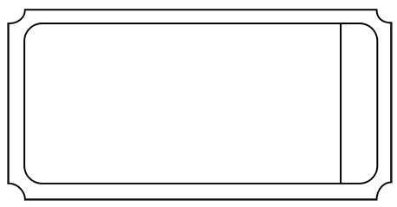


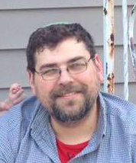
Maximizing Pricing Strategy
One Day – One Adult
Admission
$81.00
Marc Kolb
Data Scientist

Slide 2
Problem Identification
Current Pricing:
Based on Market Average
Not Capitalizing on Premium Facilities
Some Facilities Underutilized
One Day – One Adult
Admission
$81.00

Slide 3
Problem Identification
Data-Based Solution:
Optimize Ticket Pricing
Lower Maintenance Costs
Increase Margin
One Day – One Adult
Admission
$81.00

Slide 4
Recommendations and Key Findings
Recommendations:
Increase Base Ticket Price to $95.87
Close Five of the Least Used Runs
Increase Vertical Drop by 150 Feet
One Day – One Adult
Admission
$103.73

